Slide 1




2024 US Benefits Open Enrollment
October 30 – November 10, 2023
Natus Benefits Website
www.natusbenefits.com
Human Resources — October 2023

Slide 2

Welcome to Open Enrollment 2024
During the Open Enrollment presentation, you’ll learn about Natus’ ongoing commitment to your good health. You’ll also learn about changes we’ve made to key partnerships that we believe will better position us to provide competitive and affordable benefits long-term.
It’s no secret that the exploding costs of health care are putting enormous pressure on companies and participants. For 2024, plan costs are increasing by an average of ~15%...that’s simply not sustainable for most plan sponsors over the long haul.
It’s also no secret that there are really two ways to deal with these rising costs…reduce or eliminate benefits OR improve the overall health of plan participants. Uncontrolled chronic conditions and catastrophic health emergencies drive significant claims costs – investing just a fraction of those dollars in prevention pays huge dividends for YOU and for Natus.
While it’s easy to focus on just the “money” question around benefits, there’s something much larger at play in 2024 for Natus…we’re hoping to change lives!
If you’re on the BRMS/Anthem Blue Cross Plan, we’ll introduce you to our expanded partnership with Peak Health, a tool designed to empower each team member along their “good health” journey. Imagine one family that doesn’t unexpectedly lose a Father or Mother…one co-worker who doesn’t lose mobility or independence due to a debilitating health event…one friend who is able to reclaim their vitality and rewrite the narrative of their life by better managing a chronic illness or condition – those are just some of the possible outcomes of engaging in YOUR health WITH Peak Health.
We’re so sure that focusing on better health will be a game-changer, we’ve built incentives into the 2024 BRMS/Anthem Plans for those who engage in the program. You’ll learn more about Peak Health throughout this presentation.
For those on Dean Health or Kaiser plans, we’ll look to provide “good health” options based on our Peak Health learnings…but we also encourage you to begin your own “good health” journey today!
Thank you for all you do to make Natus a great place to work and a leader in the healthcare industry.
Open Enrollment 2023

Slide 3
Open Enrollment for 2024
Open Enrollment is
October 30 – November 10, 2023
Open Enrollment is your opportunity to review and confirm your benefits for 2024 to ensure that you and your dependents are adequately protected
During Open Enrollment, you may:
Enroll in or change medical, dental, and vision plan elections
Enroll in or change your voluntary benefits options
Make HSA, Health Care FSA, or Dependent Care FSA contribution elections
Add or drop eligible dependents
Waive Coverage
Reminders:
You are eligible for benefits if you are an active, full-time US employee working at least 30 hours per week
Benefits you elect, change or discontinue during the 2024 Open Enrollment will take effect on January 1, 2024
Newly hired employees need to complete elections for both 2023 and 2024 within 31 days of the hire date
During Open Enrollment, please confirm your information is accurate in PlanSource, including your designated beneficiaries. Any address changes need to be made in the Oracle HCM system.
During this open enrollment, employees will be required to sign a dependent verification agreement in PlanSource. Having only those who are eligible on the Natus plans ensures more affordable benefits for everyone. Natus periodically conducts audits and may require supporting documentation for those listed as dependents on your plan.
Open Enrollment 2023

Slide 4

Highlights for 2024
What’s New for 2024
BRMS/Anthem Blue Cross Network HDHP+HSA Plan will replace Aetna medical. Participants will need to make a new medical plan election for 2024 via PlanSource
RxBenefits and OptumRx are replacing Aetna as the Prescription Drug Manager
Deductibles for the HDHP + HSA plan will be changing to the new 2024 IRS minimum
        YOU SHOULD KNOW: Each year, the IRS sets the High Deductible Heath Plan minimums. Natus is required to build the “new” minimum deductible values into our Health coverage.
No changes to
  Dean Health or Kaiser plan designs HSA - Staying with PayFlex/Inspira
    Dental – stays with Aetna
  Vision – stays with VSP
  Basic Life/AD&D + Disability – stays with The Hartford and paid by Natus
  Aetna EAP benefits will continue to be available at no cost to employees (100% paid by Natus)
Natus’ will continue contributing to your HSA
☞ All benefit eligible employees MUST complete their open enrollment elections due to changes in contributions.
Open Enrollment 2023

Slide 5
Highlights for 2024
What’s New for 2024
BRMS/Anthem Blue Cross enrollees are eligible to receive a monthly $75 wellness incentive credit (which offsets the 2024 premium increase) by engaging in the Peak Health program!
New Teladoc Chronic Condition Support for pre-diabetes, diabetes, cardiovascular, and tobacco cessation
Voluntary Life benefits will be available in increments of $10,000 and will automatically be rounded up for current enrollees (must meet eligibility requirements)
Plan enhancements to the ARAG Legal benefit
PayFlex is becoming Inspira Financial. No changes to the FSA/HSA plans. Employees will see updated logos and branding.
New 2024 IRS contribution limits for Health Savings Plan (HSA).
Natus Benefits Website
www.natusbenefits.com
☞ All benefit eligible employees MUST complete their open enrollment elections due to changes in contributions.
Open Enrollment 2023

Slide 6



Why are we making changes to our health care programs?
Anthem Blue Cross plan with RxBenefits/Optum Rx allows Natus to more effectively manage costs with a goal of keeping the plans affordable for you. Anthem Blue Cross is a larger, National Network with greater network discounts for you and Natus. Anthem and Natus share a long-term vision of proactive health management. Helping people stay healthy is preferable to reacting to serious illness. | Health Care is a joint partnership between Natus and employees. Natus is investing in new health and chronic care programs for the overall health of our organization. We want insurance to be there when you need it – but through better health management, we also hope you’ll need it less. Controlling costs associated with chronic conditions and catastrophic claims help reduce the cost impacts to you and Natus (3% of the members are driving 54.2% of the claim dollars in many cases due to poorly managed chronic conditions). | We’re betting on better health! by encouraging participation in the Peak Health program to better support chronic care conditions and prevent future catastrophic claims Provide employees the tools to assist in achieving their health goals – Teladoc and Peak Health We know that getting your preventive check-ups can prevent future significant health issues.
Natus Plan Costs by Chronic Disease Annual Costs Per Member
Diabetes | $30,000
Asthma | $13,000
COPD | $87,181
Hypertension | $17,517
Open Enrollment 2022

Slide 7
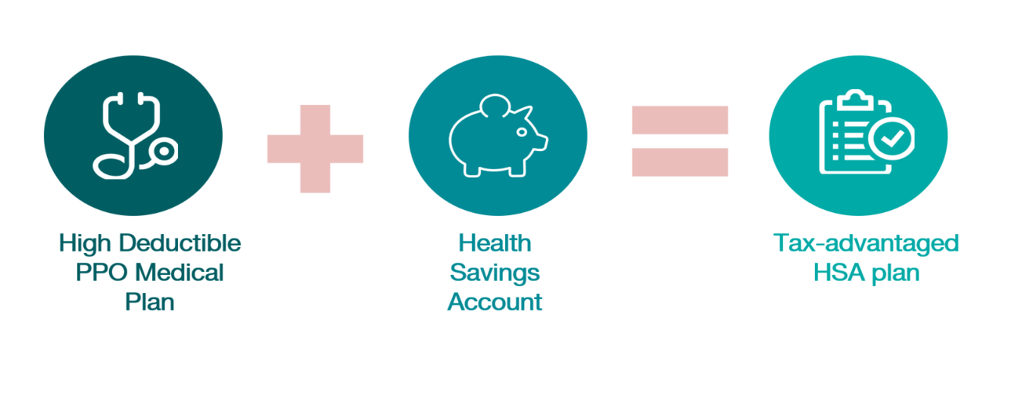
BRMS/Anthem Blue Cross Network
HDHP PPO plus a Health Savings Account
Open Enrollment 2022

Slide 8
BRMS/Anthem Blue Cross Network High Deductible Health Plan (HDHP)
 | BRMS/ANTHEM BLUE CROSS MEDICAL PLAN
 | In-network | Out-of-network
Network | Anthem Network | Anthem Network
Deductible -Individual/ Individual in family/ Family | Anthem network discounts apply $3,200/ $3,200/ $6,400 | $3,200/ $3,200/ $6,400
Out-of-Pocket Maximum -Individual/ Individual in family/ Family | Anthem network discounts apply $4,000 / $4,000 / $8,000 | $6,000/ $6,000/ $12,000
HSA Contribution from Natus -Employee Only and Employee + Spouse/ Employee + Child(ren) and Family | $1,000/ $1,500
Office Visit | 10% of discounted rate after deductible | 30% after deductible
Urgent Care | 10% of discounted rate after deductible | 30% after deductible
Preventive Care | Covered in Full | 30% after deductible
Emergency Room | 10% of discounted rate after deductible | 10% after deductible
Outpatient Surgery | 10% of discounted rate after deductible | 30% after deductible
Hospital Coverage | 10% of discounted rate after deductible | 30% after deductible
Lab & X-Ray | 10% of discounted rate after deductible | 30% after deductible
Mental Health & Substance Abuse -Outpatient -Inpatient | 10% of discounted rate after deductible 10% of discounted rate after deductible | 30% after deductible 30% after deductible
Pharmacy Retail (R)-30-day supply Mail-order (MO )-90-day supply Generic Preferred Brand Non-Pref. Brand Specialty | Preventive Medication – Deductible Does Not Apply All Other medications – Deductible Applies 10%, $10 max (R), $20 max (MO) 30%, $75 max (R), $150 max (MO) 50%, $100 max (R), $200 max (MO) 20%, $200 max (R), N/A (MO) | Not Covered
All services, except for preventative care and preventative medication, are subject to deductible.
Anthem Blue Cross network has pre-negotiated, discounted fees. When you see an Anthem provider only the discounted rate is applied to your deductible
Open Enrollment 2023

Slide 9
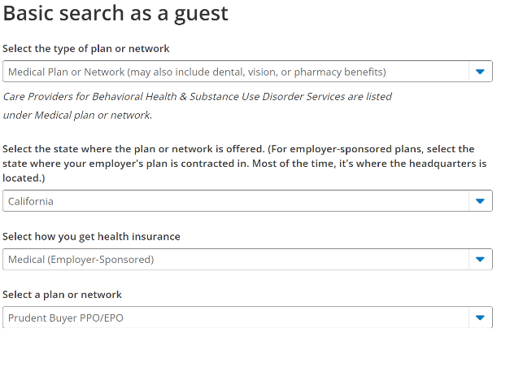
How to Find an Anthem Provider
Step 1: Visit https://www.anthem.com/ca/find-care/
Select “Basic search as a guest”
Scroll down to answer questions that will help narrow your search
Step 2: Scroll down the screen to complete the following fields:
Type of Plan – Medical
Select the state where the plan is offered - California
How you get insurance – Medical (Employer-Sponsored)
Select a Plan - Prudent Buyer PPO/EPO.
Step 3: Enter the Zip Code
Enter in the Physician's Name, Specialty, NPI or License Number in the Search Box. The results will appear below the Search Box.
You may either click on the name provided or you may click on the View All text.
Natus Benefits Website
Your Benefits - BRMS/Anthem Blue Cross
www.natusbenefits.com
Open Enrollment 2022

Slide 10


MyHealthBenefits.com – Available in 2024
With MyHealthBenefits®, you have access to an all-inclusive resource library, current benefit information, digital ID cards, our pricing comparison tool, and much more!
Log into myhealthbenefits.com to take advantage of these tools,
To register for an account, Click Create New Account.
Download the app for easy access!
Open Enrollment 2023

Slide 11
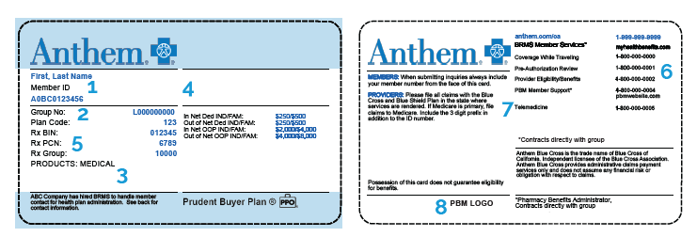

New ID Cards for BRMS/Anthem Blue Cross
Plan participants will receive new ID cards for the BRMS/Anthem Blue Cross Network Plan.
Provide your new medical ID card to your physician's office and pharmacy.
Please verify eligibility through www.MyHealthBenefits.com (starting in December) Do NOT verify with Anthem.
Providers will need to submit all claims to Anthem. Do NOT send claims to BRMS.
Open Enrollment 2023

Slide 12


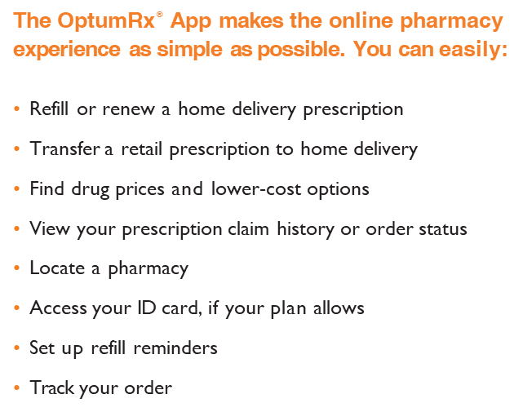
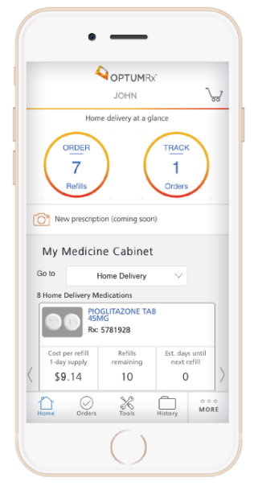
Pharmacy - RxBenefits and OptumRx
Managed by RxBenefits with OptumRx
You can still visit your local retail pharmacy. PHARMACY SEARCH
    OptumRX will manage your In-pharmacy, Mail-Order and Specialty medications
Current Mail Order and Prior Authorizations will transfer from Aetna to OptumRx.
Mail Order is more convenient and saves you money!
Visit www.optumrx.com
Who do I call with pharmacy questions?
RxBenefits at 1-800-334-8134
Open Enrollment 2023

Slide 13

Wellness Credit – Current Aetna
Natus employees who enroll in the BRMS/Anthem Blue Cross medical plan are eligible to receive a $75 monthly/$34.62 per pay period wellness incentive credit to lower your total medical premium. That’s up to $900 in incentive credits for 2024! Start NOW to get the full 2024 credit…
Current Aetna/Anthem Enrollees
Activity Required | Deadlines
Step 1 Enroll in Peak Health Platform | Complete by Dec. 15 to receive your credit until April 1, 2024
Step 2 Complete Online Health Assessment
Step 3 Obtain Lab Work* | Complete by March 15 to receive your credit after April 1, 2024
Step 4 Nurse Visit
Complete online Health Assessment (HA) by December 15, 2023
Complete Labs and meet with the Peak Health Nurse by March 15, 2024
After April 1, employees must continue to attend recurring nurse visits at the frequency determined by your nurse and the health phase you have been assigned (every, 4, 8 or 12 months apart)
Notifications are sent via email and posted in the portal by your nurse.
*Employees can upload qualifying lab work already completed
Participation in Peak Health is strictly voluntary. If you do not wish to participate, fail to complete the enrollment requirements by the noted deadlines, or fail to meet ongoing participation requirements, you will default to the full employee cost-share premiums. The deadline for the incentive credit is the 15th of each month.
Open Enrollment 2023

Slide 14

Wellness Credit – New Enrollees
New Enrollees
(Open Enrollment & New Hires)
For the first 90 days, you will receive the $75 monthly / $34.62 per pay period wellness credit.
During this 90 days, you will have to time to register on the portal, complete the Health Risk Assessment, Labs and Nurse Visit
To receive the wellness credit after 90 days, you must have completed all 4 steps.
You may start receiving the $75 monthly wellness credit the first of the month following completion of all 4 steps, even after the 90-day grace period. The deadline for completion is the 15th of each month.
90 days
Participation in Peak Health is strictly voluntary. If you do not wish to participate, fail to complete the enrollment requirements by the noted deadlines, or fail to meet ongoing participation requirements, you will default to the full employee cost-share premiums. The deadline for the incentive credit is the 15th of each month.
Open Enrollment 2023

Slide 15

Peak Health Program – How to Register
Go to www.peak-health.net/wellness
Click Register under New Users, then read and accept the Program Acknowledgment Form
Enter your Peak Health Username:
“nm” then your PlanSource ID (the first letter of your first name, the first 6 letters of your last name, and the last 4 digits of your Social Security number) e.g. nmsanders6789
Enter your date of birth (for verification purposes)
Enter your work email address
Click Register
If username and date of birth match what is on file, you will be accepted and asked to enter a new password.
Click Sign In
Natus Benefits Website
www.natusbenefits.com
https://www.natusbenefits.com/wellness-connection-peak-health
Open Enrollment 2023

Slide 16
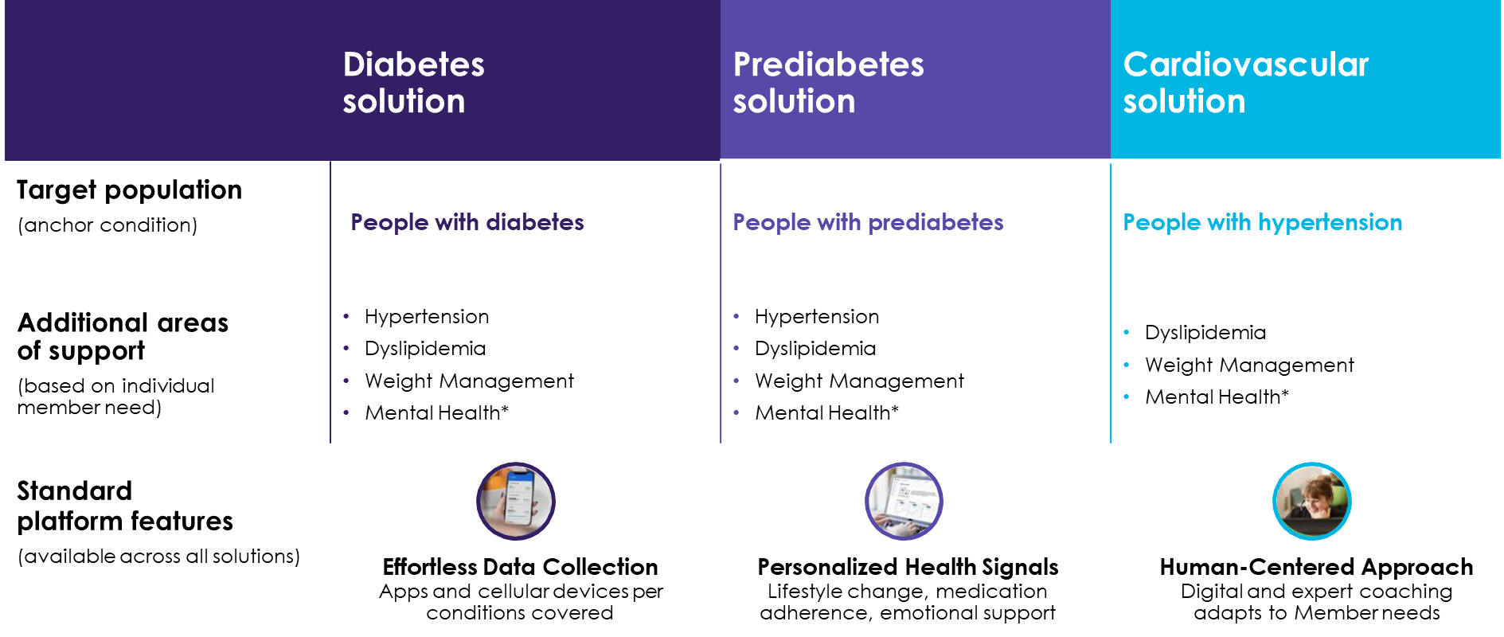
Teladoc – Chronic Condition Management
Open Enrollment 2023

Slide 17

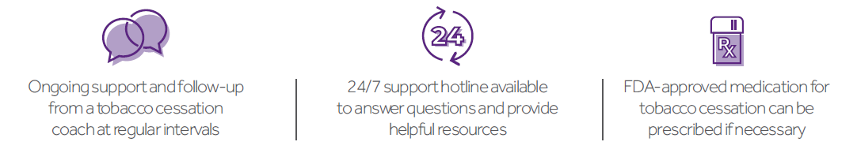
Tobacco Cessation
Quit for good with a proven support plan
Teladoc gives you the resources, support and accountability you’ll need to get
through each day tobacco-free.
To enroll in our free Tobacco Cessation program, simply request a General Medical visit and tell the doctor you’re interested in the program.
Open Enrollment 2023

Slide 18




Teladoc Health and Resources
BRMS/Anthem Blue Cross members have access to Teladoc.
Telemedicine is convenient way to access qualified doctors. It is an affordable alternative to costly urgent care and emergency room visits when you need care now.
It also allows for private appointments from your home.
Teladoc Health and Resources include:
General Medical: members have access to U.S. board-certified adult and pediatric doctors on demand by phone or video, they have easy access to the care they need from wherever they are.
Mental Health: members conveniently speak with board-certified psychiatrists, licensed psychologists or therapists by video or phone from wherever they feel most comfortable. After time for first visit – 7 days
Offered 7 days a week by phone or video
Network of board- certified psychiatrists and psychologists and licensed therapists
☞ Natus offers programs and resources that can help with anxiety, depression or other issues related to your emotional well-being.
Open Enrollment 2023

Slide 19





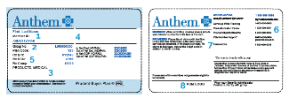


Transition
Register on the MyHealthBenefits online/mobile app with BRMS
Register on OptumRx online/mobile app
Refill your prescriptions in December if possible
Give your doctor and pharmacy your new card starting January 1
If you have any transition of care concerns such as 3rd trimester or ongoing critical treatment contact Natus Benefits
December 2023
January 2024
Open Enrollment 2023

Slide 20



Health Savings Account - Inspira
Why HSA?
Triple Tax Benefits
  Contributions to an HSA (from both you and Natus) are tax-free*
  Interest and investment earnings on the account are tax-free*
  Funds withdrawn from the account for qualified expenses are tax-free*
How does the Health Savings Account (HSA) work?
HSA is a tax advantaged employee-owned savings account that can be used to pay for qualified medical, dental or vision expenses not covered by the health plans
An HSA account must be paired with a high-deductible health plan
An HSA account is easy to use – it works like a debit card that is linked to the funds in your account
Natus makes significant contributions to employee’s HSA account each January and July
  HSA funds roll over each year, allowing you to build a savings account for health care expenses or for retirement
  Once your HSA balance reaches $1,000, you are offered the opportunity to invest these funds and let them grow tax-free
  After age 65, you can spend HSA money on unqualified expenses without paying a tax penalty, but are subject to applicable income taxes
* HSA funds are not taxed at a federal income tax level when used appropriately for qualified expenses. Most states recognize HSA funds as tax-free with few exceptions. Consult a tax advisor for more information.
Open Enrollment 2023

Slide 21
Health Savings Account
Natus makes a contribution to employee HSA accounts each January and July
HSA contributions are subject to the IRS limit
Participants cannot have disqualifying coverage such as other non-HDHP health plan, spouse’s FSA plan, Medicare etc.
Are you eligible for an HSA?
You’re eligible once you’re enrolled in a qualified high-deductible health plan, with a few exceptions. You may not have:
• Medicare or TRICARE®
• Other health coverage that pays out-of-pocket health care expenses before you meet your plan deductible
• A general-purpose health care flexible spending account or health reimbursement arrangement in the same year
• Veterans Affairs medical benefits used in the last three months, unless the hospital care or medical services were for a service-connected disability
• Someone claim you as a dependent on their tax return
Annual Contribution by Tier | From Natus | From Employee | 2024 IRS Limit*
Employee Only | $1,000 | Up to $3,150 | $4,150
Employee + Spouse | $1,000 | Up to $7,300 | $8,300
Employee + Child(ren) | $1,500 | Up to $6,800 | $8,300
Employee + Family | $1,500 | Up to $6,800 | $8,300
* Individuals aged 55 or older are allowed to make a catch-up contribution of $1,000 over the 2024 IRS limit. In addition, individuals enrolled in Medicare are not eligible to contribute to HSA.
Open Enrollment 2023

Slide 22
Kaiser
 | Kaiser HMO in California Kaiser HMO in Washington
 | In-network only | In-network only
Network | Kaiser California | Kaiser Washington
Deductible Individual/ Individual in family/ Family | $0/ $0/ $0 | $0/ $0/ $0
Out-of-Pocket Maximum Individual/ Individual in family/ Family | $3,500/ $3,500/ $7,000 | $3,500/ $3,500/ $7,000
Office Visit | $30 PCP copay; $50 Specialist copay | $25 PCP copay; $50 Specialist copay
Urgent Care | $30 copay | $25 copay
Preventive Care | Covered in Full | Covered in Full
Emergency Room | $150 copay / visit | $150 copay / visit
Outpatient Surgery | $250 copay / procedure | $250 copay / procedure
Hospital Coverage | $500 copay / day | $500 copay / day up to $2,500 / admission
Diagnostic Lab & X-Ray | $10 / encounter | No charge
Mental Health & Substance Abuse Outpatient Inpatient | $30 copay / individual visit $500 copay / day | $25 copay / individual visit $500 copay / day up to $2,500 / admission
Retail Pharmacy (30 days) Generic Preferred Brand Non-Pref. Brand Specialty | $15 copay $35 copay 30%, $250 max | $10 copay $35 copay $70 copay
New 2024 – Kaiser WA Hearing aids covered 3K per ear per 36 months
Open Enrollment 2023

Slide 23
Dean Health Plan – Wisconsin Only
 | Dean Health Plan
 | In-network only
Network | Dean Health Plan
Deductible Individual/ Individual in family/ Family | $1,500/ $1,500/ $3,000
Out-of-Pocket Maximum Individual/ Individual in family/ Family | $3,000/ $3,000/ $6,000
Office Visit | $30 PCP copay; $50 Specialist copay
Urgent Care | $30 copay and/or 0% coinsurance after deductible
Preventive Care | Covered in Full (deductible waived)
Emergency Room | $125 copay/visit and/or 0% coinsurance after deductible
Outpatient Surgery | $500 copay / admission to facility; deductible applies for physician/surgeon fees ($1,000 max per year)
Hospital Coverage | $500 copay / admission to facility; deductible applies for physician/surgeon fees ($1,000 max per year)
Diagnostic Lab & X-Ray | 0% after deductible
Mental Health & Substance Abuse Outpatient Inpatient | $30 copay / individual visit $500 copay / admission ($1,000 max per year)
Retail Pharmacy (30 days) Tier 1 Tier 2 Tier 3 Tier 4 | $10 copay $30 copay $50 copay 30% coinsurance
Open Enrollment 2023

Slide 24

Enhanced EAP services through Resources for Living
Free, confidential 24/7 support for all Natus employees at 1-800-342-8111.
Confidential counseling and referral services for up to 10 visits per issue with unlimited issues
Available at no cost to you and all members of your household. Includes dependent children up to age 26, whether or not they live at home.
Resources for Living (RFL) clinicians provide support for:
Work/life balance challenges
Parenting issues
Child and elder care referrals (Daycare, special needs, assisted living)
Disaster support (i.e., COVID-19, wildfires, hurricanes)
Dealing with depression
Drug & substance abuse
Legal counseling + referrals (free 30-minute consultation per issue)
Financial counseling + referrals (free 30-minute consultation per issue)
Self-improvement
Convenience Services (Realtors, plumbers, etc.)
Connect with a Counselor
Counseling Services
Unlimited telephone support
10 free therapy sessions (per issue) with unlimited issues. Sessions can be in-person or televideo
TalkSpace (Chat Therapy)
Send text, audio, or video messages directly to your therapist. One week of therapy is equal to one counseling session
No need to set up an appointment, your counselor will respond daily (HIPPA-compliant)
☞ Natus offers programs and resources that can help with anxiety, depression or other issues related to your emotional well-being.
Open Enrollment 2023

Slide 25




Additional Mental Health Support
If you exhaust the 10 virtual or in-person visits (per issue) with Resources for Living, you may obtain additional care from your medical plan providers. In some cases, your counselor will help you transition care with your medical provider
In-network providers charge lower, in-network fees
Out-of-network providers charge higher fees, and they may bill you for the amounts not covered by your medical carrier.
Mental health resources through your medical provider:
Virtual care through Teladoc
Behavioral health programs to fit your specific needs
Condition management
Member discounts
Robust online portal
Virtual care
Behavioral health with case management
WebMD wellness portal
Living Healthy wellness program
Virtual care
Behavioral health coaching
Healthy Lifestyle and wellness coaching
Member discounts
Robust online portal
Open Enrollment 2023

Slide 26
Aetna Dental - DMO and PPO Dental Plans
 | DMO | PPO
Annual Deductible (Waived for preventive) Individual Family | N/A None None | Yes $50 $150
Annual Maximum (for Preventive, Basic, and Major) | None | $1,500
Preventive (Exams, Cleanings, Fluoride, X-Rays) | 100% | 100%
Basic (Fillings, Extractions) | 100% | 80%
Major (Inlays, Crowns, Dentures) | 50% | 50%
Orthodontia (Adult and Child) | 50% | 50%
Orthodontic Lifetime Maximum | 24 months of comprehensive orthodontic treatment plus 24 months of retention. | $1,500
Aetna offers two dental plans administered by Aetna (Aetna DMO and PPO).
Note that dental benefits are bundled with vision and may not be elected separately.
Learn More & Find a Provider:
Visit www.aetna.com for a more detailed description of how to use the dental plans and locate DMO and PPO providers.
DMO: DMO/DNO/Managed Dental > DMO/DNO
PPO: Dental PPO/PDN with PPOII Network >Dental PPO/PDN with PPO II
Open Enrollment 2023

Slide 27

Vision - VSP
 | VSP Provider | Non-VSP Provider
Copayments -Examination Copay -Glasses Copay -Lenses Copay | $20 copay $20 copay Up to $60 copay | None None None
Examination – Insurance Coverage Once every 12 months | 100% | Up to $50
Lenses – Insurance Coverage Once every 12 months -Single Vision Lenses -Bifocal Lenses -Trifocal Lenses | 100% 100% 100% | Up to $50 Up to $75 Up to $100
Frames – Insurance Coverage Once every 24 months | $150/$170 allowance | Up to $70
Contact Lenses – Insurance Coverage -In lieu of Lenses & Frames -Necessary Elective | $150 allowance 100% | Up to $105 Up to $210
Additional Benefits with VSP
Affiliate Providers: VSP has contracts with affiliate providers such as Costco. Check with Costco for member pricing on frame and lens options.
Discounted Frames: VSP offers a $20 discount on featured frame brands like Calvin Klein, Diane von Furstenberg, Valentino, Sean John, and many more. To find a doctor who carries the discounted brands, visit www.vsp.com.
Open Enrollment 2023

Slide 28
Bi-Weekly Employee Contributions for Health Plans
2024 Health Plans | Bi-weekly Employee Contributions for Health Plans
 | Employee Only | Employee + Spouse | Employee + Child(ren) | Employee + Family
BRMS/Anthem Blue Cross HDHP with HSA | $84.25 Wellness Credit $118.86 – No credit | $192.50 Wellness Credit $227.11 – No credit | $130.74 Wellness Credit $165.36 – No credit | $288.00 Wellness Credit $322.62 – No credit
Kaiser CA HMO (CA Only) | $65.51 | $170.40 | $134.26 | $270.58
Kaiser WA HMO (WA Only) | $56.47 | $146.87 | $115.72 | $233.21
Dean Care HMO (WI Only) | $38.20 | $99.11 | $78.13 | $157.71
Aetna Dental HMO + Vision | $4.97 | $11.03 | $12.61 | $17.32
Aetna Dental PPO + Vision | $9.00 | $20.75 | $23.50 | $32.75
Open Enrollment 2023

Slide 29

Flexible Spending Account Admin Update
Starting in early 2024, PayFlex is becoming Inspira
You can expect a seamless experience without an interruption in service.
Open Enrollment 2023

Slide 30

Health Care Flexible Spending Account
Allows you to set aside a portion of your income on a pre-tax basis to pay for qualified health expenses
You must use your elected Health Care FSA dollars during the year, or you will lose them
Must pro-actively enroll in the plan each year; your election from the prior year does not automatically rollover
There are two types of Health Care FSA
 | General Purpose Health FSA | Limited Purpose Health FSA
Purposes | To pay for qualified medical, dental, vision expenses | To pay for qualified dental and vision expenses
HSA Restriction | Not allowed if enrolled in HSA | Allowed if enrolled in HSA
Rollover Maximum* | $610 | $610
Maximum Election* | $3,200 in 2024 | $3,200 in 2024
Eligible Expenses | Medical, dental and vision Deductibles, copays, co-insurance Over the counter medications | Dental and vision only
You can search for eligible expenses at : https://www.payflex.com/en/individuals/products-programs-health-care-fsa.html
* Limit is required by the IRS.
Open Enrollment 2023

Slide 31

Dependent Care Flexible Spending Account
Used to pay for qualified dependent care expenses, such as preschool, summer day camp, before / after school programs and child or adult daycare
You must use your elected Dependent Care FSA dollars during the year, or you will lose them
Must pro-actively enroll in the plan each year; your election from the prior year does not automatically rollover
 | Dependent Care FSA
Purposes | To pay for qualified child and elder care expenses
Maximum Election* | $2,500 if you file taxes as married and filing separately $5,000 if you file as married and filing on a joint tax return
* Limit is required by the IRS. In addition, if you make more than $130,000/year, you may be subject to a lower annual limit on the Dependent Care FSA election according to IRS rules.
Open Enrollment 2023

Slide 32

Natus Provided Income Protection Plans
 | Benefits
Life Insurance | Two times your annual salary to $500,000
Accidental Death & Dismemberment Benefit | Two times your annual salary to $500,000
Short-Term Disability | 60% of total weekly earnings to a maximum of $3,000, beginning the 8th day of illness or injury and payable for up to 12 weeks
Long-Term Disability | 50% of total monthly earnings to a maximum of $8,500, beginning 90 days from the date of disability
Life, AD&D, and Disability Benefits Natus covers 100% of premium cost for employees
Open Enrollment 2023

Slide 33
Voluntary Benefits that Provide Financial Protection
Buy-up Short-Term Disability, Accident, Critical Illness, Hospital Indemnity
Provided by The Hartford
Insurance to protect you financial if you are unable to work, or when you experience unexpected illness or medical emergencies
Natus Benefits
Travel Assistance Services
Provided by The Hartford
Multilingual assistance, 24/7, in US or 200 other countries at no cost
Provides emergency and non-emergency services when traveling >100 miles from home for <90 days
Services include pre-trip information, emergency medical assistance or personal assistance
Travel Assistance
Identity Theft Protection, Legal Advice
IdentityForce/Sontiq (ID Theft) provides cyber internet surveillance & child social network monitoring
IdentityForce
ARAG (Legal Advice) provides access to network of qualified attorneys via phone or office consultation.
ARAGlegal.com/myinfo Access Code: 18659nm.
Long-Term Care
Provided by Chubb
Coverage to help plan for the high cost of long-term care.
http://www.myltcguide.com/natus
Open Enrollment 2023

Slide 34

Voluntary Life Insurance
Voluntary Life Benefits
Employee Benefit:
Increments of $10,000 up to $500,000. If you are already enrolled in the employee voluntary life plan, your current election will automatically round up to the next $10,000.
Spouse Life:
Any multiple of $5,000 to a maximum of $250,000, but not to exceed 100% of the employee’s approved election. You may not elect coverage for your spouse if you do not elect coverage for yourself. You may not elect coverage for your spouse if your spouse is covered as an employee under this policy.
  Child Life:
  Coverage of $10,000 is available for your child(ren) to age 26 as long as you elect supplemental life coverage for yourself.
  Evidence of Insurability is generally required for any benefit amount for new enrollees, unless you are a new hire and this is the first time the plan is being offered to you. For new hires, Evidence of Insurability is required above the following amounts:
  Employee: $350,000 and Spouse: $50,000
Buying life insurance is an important element of sound financial planning. Open Enrollment is an opportunity to assess if you have sufficient life insurance to take care of your loved ones and pay for expenses should you become disabled or pass away.
Open Enrollment 2021

Slide 35
How to Enroll for Benefits
Do I need to login?
Yes!
Participants will need to make a new medical plan election for 2024 because of the carrier change from Aetna to BRMS/Anthem.
FSA elections do not rollover. If you’d like to enroll in the FSA, you must re-enroll each year.
Make Open Enrollment elections through the PlanSource enrollment platform
Log in: Log into PlanSource between October 30 and November 10, 2023
All passwords have been reset
Locate your username:
Your username will be the first initial of your first name, followed by first six letters of your last name (or less for last names with fewer than six letters) and the last four digits of your SSN
Use your unique password:
Your password is your birthdate in the format YYYYMMDD
Complete your enrollment by November 10, 2023
Open Enrollment 2023

Slide 36



Resources
Natus Benefits Call Center
5:00 am – 8:00 pm PT
Monday - Friday
Phone: 866-967-0251
NatusBenefits@Plansource.com
Natus Benefits Website
www.natusbenefits.com
Carrier Customer Service
BRMS: 1-877-713-2917
Anthem: TBD
Optum Rx through RxBenefits: 1-800-880-1188
Kaiser CA: 1-800-464-4000
Kaiser WA: 1-888-901-4636
Dean Care: 1-800-279-1301
Open Enrollment 2023

Slide 37

Questions?
Open Enrollment 2023

Slide 38

Teledentistry
A virtual dental care option is available to Natus employees enrolled in one of the Aetna dental plans.
Teledentistry offers members choice and convenience
Members can connect with dentists through virtual visits using technology such as Facetime or Skype.
Dental providers can offer routine and/or oral evaluations, answer questions, give advice, prescribe medicine and refer patients to specialists, if needed.
Teledentistry helps avoid unnecessary travel and costs, emergency room visits or time away from work or school.
Aetna will consider services (ADA codes) rendered via virtual visit the same as services performed in the office when submitted by a licensed dentist.
Open Enrollment 2023

Slide 39

Accident Insurance
EMERGENCY, HOSPITAL & TREATMENT CARE
Accident Follow-Up | Up to 3 visits per accident | $100
Acupuncture/Chiropractic Care/PT | Up to 10 visits each per accident | $50
Ambulance – Air | Once per accident | $1,200
Ambulance – Ground | Once per accident | $400
Blood/Plasma/Platelets | Once per accident | $300
Child Care | Up to 30 days per accident while insured is conﬁned | $30
Daily Hospital Conﬁnement | Up to 365 days per lifetime | $300
Daily ICU Conﬁnement | Up to 30 days per accident | $600
Diagnostic Exam | Once per accident | $300
Emergency Dental | Once per accident | Up to $450
Emergency Room | Once per accident | $200
Hospital Admission | Once per accident | $1,500
Initial Physician Ofﬁce Visit | Once per accident | $100
Lodging | Up to 30 nights per lifetime | $150
Medical Appliance | Once per accident | $150
Rehabilitation Facility | Up to 15 days per lifetime | $150
Transportation | Up to 3 trips per accident | $500
Urgent Care | Once per accident | $100
X-ray | Once per accident | $75
SPECIFIED INJURY & SURGERY |  | PLAN
Abdominal/Thoracic Surgery | Once per accident | $2,000
Arthroscopic Surgery | Once per accident | $400
Burn | Once per accident | Up to $15,000
Burn – Skin Graft | Once per accident for third degree burn(s) | 25% of burn beneﬁt
Concussion | Up to 3 per year | $200
Dislocation | Once per joint per lifetime | Up to $8,000
Eye Injury | Once per accident | Up to $600
Fracture | Once per bone per accident | Up to $9,000
Hernia Repair | Once per accident | $200
Accident Insurance Bi-weekly Rates
Per Employee | $4.83
Employee + Spouse | $7.62
Employee + Child(ren) | $8.26
Employee + Family | $12.92
Open Enrollment 2023

Slide 40

Critical Illness Insurance
COVERAGE AMOUNTS
Employee Coverage Amount | $10,000
Spouse Coverage Amount | 50% of your coverage amount
Child(ren) Coverage Amount | $5,000
COVERED ILLNESSES | BENEFIT AMOUNTS
CANCER CONDITIONS
Benign Brain Tumor*; Invasive Cancer* | 100% of coverage amount
Non-invasive Cancer | 25% of coverage amount
VASCULAR CONDITIONS
Heart Attack*; Heart Transplant*; Stroke* | 100% of coverage amount
Aneurysm; Angioplasty/Stent; Coronary Artery Bypass Graft | 25% of coverage amount
OTHER SPECIFIED CONDITIONS
Coma*; End Stage Renal Failure; Loss of Hearing; Loss of Speech; Loss of Vision; Major Organ Transplant*; Paralysis | 100% of coverage amount
Bone Marrow Transplant | 25% of coverage amount
ADDITIONAL BENEFITS | BENEFIT AMOUNTS
Recurrence – Pays a beneﬁt for a subsequent diagnosis of conditions marked with an asterisk (*) | 50% of your coverage amount
Health Screening Beneﬁt | $50 per person per year
FEATURES | BENEFIT AMOUNTS
Coverage Maximum – Primary Insured & Spouse | 500% of coverage amount
Coverage Maximum – Child(ren) | 300% of coverage amount
Ability Assist® EAP2– 24/7/365 access to help for ﬁnancial, legal or emotional issues
HealthChampionSM2 – Administrative and clinical support following serious illness or injury
Age | Employee | Employee & Spouse | Employee & Child(ren) | Family
18-24 | $1.38 | $2.24 | $2.10 | $3.07
25-29 | $1.66 | $2.66 | $2.37 | $3.49
30-34 | $1.86 | $2.96 | $2.57 | $3.80
35-39 | $2.36 | $3.73 | $3.08 | $4.56
40-44 | $3.33 | $5.22 | $4.05 | $6.05
45-49 | $5.13 | $8.00 | $5.85 | $8.84
50-54 | $7.11 | $11.07 | $7.83 | $11.91
55-59 | $9.66 | $15.04 | $10.38 | $15.88
60-64 | $13.53 | $21.02 | $14.24 | $21.85
65-69 | $18.54 | $28.68 | $19.26 | $29.51
70-74 | $12.56 | $19.49 | $13.08 | $20.10
75-79 | $16.39 | $25.31 | $16.91 | $25.91
Open Enrollment 2023

Slide 41

Hospital Indemnity Insurance
PLAN INFORMATION |  | PLAN
Coverage Type |  | On and off-job (24 hour)
Covered Events |  | Illness and injury
HSA Compatible? |  | Yes
BENEFITS
HOSPITAL CARE2 |  | PLAN
First Day Hospital Conﬁnement | Up to 1 day per year | $1,000
Daily Hospital Conﬁnement (Day 2+) | Up to 30 days per year | $150
Daily ICU Conﬁnement (Day 1+) | Up to 30 days per year | $300
FEATURES
Ability Assist® EAP2 – 24/7/365 access to help for ﬁnancial, legal or emotional issues |  | Included
HealthChampionSM2 – Administrative & clinical support following serious illness or injury |  | Included
Hospital Indemnity Insurance | Bi-weekly Rates
Per Employee | $5.79
Employee + Spouse | $12.20
Employee + Child(ren) | $11.01
Employee + Family | $18.28
Open Enrollment 2023

Slide 42

New! Long-Term Care
Chubb Life Insurance with Long Term Care Benefit
This plan provides three ways to receive benefits:
LTC Insurance
Life Insurance
Life and LTC Insurance
Chubb Life Insurance + LTC combines the benefits of life insurance with living benefits which can be utilized for Long-Term Care, including:
  Skilled nursing facilities
  Memory care
  Assisted living facilities
  Continuing care retirement communities
  Coverage available for both for-profit and non-profit entities.
Do Something Today - That Your Future Self Will Thank You For
Open Enrollment 2021

Slide 43






Connect with Resources for Living
Call 1-800-342-8111
Services are available 24 hours a day, 7 days a week
www.resourcesforliving.com
Username: Natus
Password: eap
  Articles, video, live and on-demand webinars, assessments, disaster/crisis resources, etc.
  Online legal form library including wills
  LifeMart – Savings though the Aetna discount center
Resources for Living app
Sign up for TalkSpace
Log on to www.resourcesforliving.com & go to Services
Select “Sign up for Talkspace”
Choose a therapist and begin messaging the very same day
There’s no limit to the number of messages you can send to your dedicated therapist.
MyStrength
1. Sign up with code: Natus
2. Create personal password
  Free digital tools to bolster emotional health and overall wellbeing
  E-learning activities focusing on stress, anxiety, depression, insomnia, substance misuse, chronic pain, nicotine recovery and more
Open Enrollment 2023

