Slide 1
All About ARAG® Legal Insurance

Slide 2
Agenda
Why Legal Insurance?
1
How Does It Work?
2
Contact Us
3

Slide 3
Why Legal Insurance Legal issues don’t discriminate by age, income, gender or marital status.
Bullying & cyberbullying
Caring for an aging parent
Getting married
Child identity theft
Home renovations
Estate planning & advance directives
Dispute with a landlord
Starting a family
Traffic tickets & moving violations
Senior citizen identity theft
Settling a loved one’s estate
Buying a house
Divorce
Underage
drinking
Debt issues

Slide 4
How Legal Compares to Medical
When you have a legal issue and need an attorney…
When you have a medical issue and need a doctor…
Go online or call your legal insurance company to determine coverage.
Go online or call your insurance company to determine coverage.
Get connected with local attorneys
in the network who can help you.
Get connected with local doctors in the network who can help you.
Make an appointment with an attorney in the network.
Make an appointment with a doctor in the network.
Talk about next steps, like creating legal documents, receiving follow-up guidance or going to court.
Talk about next steps, like prescribing medication, reviewing medical procedures and scheduling follow-ups.
Consider scheduling periodic check-ups with an attorney to review your legal matters and plan ahead.
Consider scheduling a check-up with your doctor each year to review your health and help prevent medical issues.

Slide 5
Common Ways Members Use Legal – The Top 10
1
2
3
4
5
WILLS
TRUSTS
BUYING/SELLING
A HOME
CONSUMER PROTECTION
DIVORCE
6
7
8
9
10
TRAFFIC
NEIGHBOR, REAL ESTATE AND TENANT DISPUTES
CHILD CUSTODY AND SUPPORT
BANKRUPTCY
ADMINISTRATIVE
HEARINGS
Data represented is based on unique legal matters with claims paid in 2021.

Slide 6
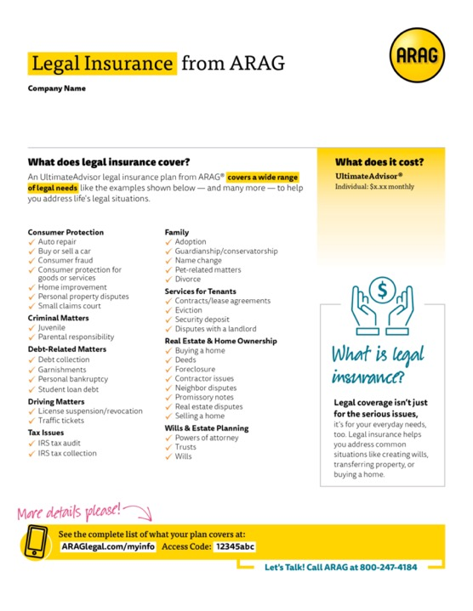
Navigating Legal Issues Can Be Costly
Legal Issue | Average Attorney Fees Without a Legal Plan¹ | Network Attorney Fees with an ARAG Legal Plan²
1. Wills | $1,509 | $0
2. Trusts | $1,840 | $0
3. Traffic | $1,251 | $0
4. Property Transfers | $1,693 | $0
¹Average cost to employee without legal insurance is based on the average number of attorney hours for claims incurred in 2019 or 2020 and paid by December 31, 2021, multiplied by $368 per hour. $368 is the average hourly rate for a U.S. attorney with 11 to 15 years experience according to The Survey of Law Firm Economics: 2018 Edition, The National Law Journal and ALM Legal Intelligence, October 2018.
²Attorney fees are 100% paid in full when using an ARAG network attorney for most covered legal matters.

Slide 7
ARAG Has Your Back
Member Chooses Service Delivery
 | In-Person Legal Services Work with a network attorney in office or virtually for advice, document prep/review and representation. | Knowledgeable Advisor Comprehensive Coverage Representation
 | Telephone Services Connect with a telephone network attorney over the phone for legal advice and document prep/review. | Convenient Flexible Inclusive
 | Online Resources Use online tools and apps to manage and learn more about legal matters. | Learning Center DIY Docs® ARAG Legal App

Slide 8
Best-In-Class Benefits
UltimateAdvisor®
Civil Damage Claims (Defense)
Defense of Civil Damage Claims
Pet-Related Matters
Consumer Protection Matters
Consumer Protection
- Auto Repair Disputes
- Buying or Selling a New or Used Automobile
- Consumer Fraud
- Consumer Protection for Goods and Services
- Contracts & Financial Disputes
Insurance Disputes
Criminal Matters
Habeas Corpus
Juvenile Court Proceedings
Parental Responsibilities
Criminal Misdemeanor
Debt-Related Matters
Debt Collection
Garnishment
Mechanic’s Lien
Personal Bankruptcy
Student Loan Debt Collection
Family Law
Adoption Proceedings Uncontested
Adoption Proceedings Contested
Alimony (up to 8 hours)
Child Custody (up to 8 hours)
Child Support (up to 8 hours)
Child Visitation Rights (up to 8 hours)
Conservatorship Uncontested
Conservatorship Contested
Elder Law
Divorce Uncontested
Divorce Contested (up to 20 hours)
Domestic Violence
Guardianship Uncontested
Guardianship Contested
Incapacity
Name Change Proceedings
Prenuptial Agreements
School Issues
Restraining Orders
General Matters
Credit Records Correction
Document Preparation
- Affidavits
- Bill of Sale
- Demand Letters
- Promissory Notes
- HIPAA Authorization
Document Review
Personal Property Disputes
Government Benefits
Medicare/Medicaid Disputes
Social Security Disputes
Veterans Benefits Disputes
Services for Tenants
Contracts/Lease Agreements
Eviction
Security Deposits
Tenant Disputes with a Landlord
Real Estate Matters
(Primary and Secondary Residence)
Building Codes
Home Improvement/Contractor Disputes
Home Equity Loan
Deeds and Mortgages
Easements
Eminent Domain
Foreclosure
Neighbor Disputes
Purchase/Sale of House
Real Estate Disputes
Refinancing
Zoning & Variances
Small Claims Court
Small Claims Assistance
Tax Matters
IRS Audit Protection
IRS Collection Defense
Property Tax (Primary & Secondary Residence)
State and Local Tax Audit
State and Local Tax Collection Defense
Traffic Matters
Drivers License Suspension & Revocation
Drivers License Restoration
Minor Traffic Ticket
Wills and Estate Planning
Codicil
Durable/Financial Power of Attorney
Estate Administration (up to 9 hours)
Health Care Power of Attorney
Irrevocable Trusts
Living Will
Revocable Trusts
Standard/Complex Will
Additional Services
Supplemental Legal Coverage (up to 4 hours)
Identity Theft Protection
Financial Education and Counseling Services
Tax Services
Services for Parents/Grandparents
Reduced Fee/Contingency
Identity Theft Services
Immigration Assistance
Learning Center
DIY Docs®
Approved by Legal
7/2018

Slide 9
A Closer Look at ARAG’s Additional Services
Identity Theft Protection | Services for Parents/Grandparents | Financial Counseling & Education | Tax Services
$1 million identity theft insurance* Full-service identity restoration Internet surveillance Single-bureau credit monitoring Lost wallet services Child identity monitoring Change of address monitoring | Legal hotline Annual legal check-up Reduced fee services** Caregiving support services Online caregiving resources Negotiated discounts*** | Financial counseling Debt management plan Online financial tools Savings & budgeting Asset allocation Credit reports IRAs & 401(k)s Debt consolidation Student loan debt | Tips for state or federal filing of personal taxes Explanation of tax law changes Research on complex personal tax matters Advice regarding IRS Audits and notifications Review of previous year’s personal tax return Discounted personal tax return preparation
*The Identity Theft Insurance is underwritten and administered by American Bankers Insurance Company of Florida, an Assurant company. Please refer to the actual policies for terms, conditions, and exclusions of coverage. Coverage may not be available in all jurisdictions. Please see the plan summary document for details.
** Reduced Fee Services for parents/grandparents when using a network attorney.
*** On rates of assisted living facilities, nursing homes, home health care agency and adult care providers when available.

Slide 10
FAQs
What costs are covered?
One of the most valuable features of the plan is that ARAG pays 100% of network attorney fees for most covered (and not excluded) legal matters. Expenses and fees related to “hard costs” such as filing fees, copy costs, etc. are not covered.
What happens if an issue isn’t covered?
If an issue is not covered by the plan (and not specifically excluded), members still have coverage options. For example, they may still be eligible to work with an ARAG network attorney and receive at least 25% off the attorney’s normal hourly rate. To get the reduced fee, members will need to present their member identification number or CaseAssist® confirmation number to the network attorney before any work proceeds.

Slide 11
FAQs
How many network attorneys are available in the area?
There are more than 15,000 attorneys in the ARAG attorney network nationwide. For a specific list of local attorneys, a member can contact ARAG Customer Care, log in to their account at ARAGlegal.com or use the ARAG Legal app. To help you have the best experience possible, a Customer Care specialist can assist you in connecting with a network attorney and ensure you receive full plan benefits on covered legal matters.

Slide 12
FAQs
Can members use attorneys outside the ARAG network?
Yes. If the member would like to retain and work with a non-network attorney:
The member should contact Customer Care to make sure the legal matter is covered.
The member is billed directly by the attorney and the member pays the attorney for services rendered.
The member is then required to provide ARAG with appropriate documentation ̶ including an ARAG non-network attorney claim form.
The member will be reimbursed for covered attorney fees up to the benefit amount indicated in the legal plan.

Slide 13
FAQs
What are considered pre-existing conditions?
If a member has a legal matter that occurs or is initiated prior to the plan’s effective date, it’s considered “excluded” and no in-office benefits will apply. The initiation date will be considered the earlier of the date:
A written notice of a legal dispute is sent, filed or received by you
A ticket or citation is issued
An attorney is hired
However, other benefits may be available. Even if the matter is considered pre-existing, as long as it is not listed under the “Exclusions” in the plan, and so long as an attorney has not been hired, the member is able to receive advice from a network attorney under the “Telephone Legal Access Services” benefit as well as receiving reduced fee legal services of at least 25 percent off the network attorney’s normal hourly rate.

Slide 14
FAQs
What’s excluded?
ARAG essentially defines an exclusion as “a matter or event not covered by the plan.” Based on that, the following would be excluded:
Matters against ARAG, the employer or an insured against the interests of the named insured under the same Certificate.
Legal services arising out of a business interest, investment interests, employment matters, employee benefits, your role as an officer or director of an organization and patents or copyrights.
Legal services in class actions, personal injury, punitive damages, malpractice, court appeals or post judgments (settlement agreement signed by all parties, final binding arbitration, judgment issued by a court).
Legal services deemed by ARAG to be frivolous or lacking merit, or in legal matters where you wish to take action against a party, regardless of whether the matter proceeds to you filing a lawsuit against the other party, and the amount we pay for your legal services exceeds the amount in dispute, or in our reasonable belief you are not actively and reasonably pursuing resolution in your case.

Slide 15
FAQs
If an employee leaves, can they continue the plan?
When ARAG is notified that a member is terminated from the plan, we automatically send out conversion information to the member’s email or mailing address on file. In the email, the member is notified about their options to enroll in a similar plan on a direct pay basis. Payments are made to ARAG. The member then has 90 days from date of separation from their employer to elect the conversion plan on a direct pay basis.
ARAG also provides valuable legal protection to both members and their dependents for different situations they may encounter. For example, ARAG will continue to provide coverage and waive the premium, for a designated period of time, if the named insured should happen to pass away or in the case of a military deployment.
Members can contact our Customer Care Center with questions.

Slide 16
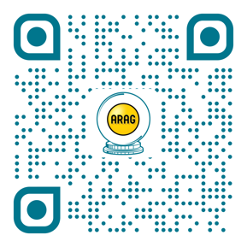
YOU CAN’T PREDICT THE FUTURE, BUT YOU CAN PLAN FOR IT.
Go to
ARAGlegal.com/future
Play a free “Flip Your Fortune” game to see what legal needs could be in your future
Learn more about legal coverages offered through your employer
Watch humorous glimpses of employees' legal needs in the future

Slide 17
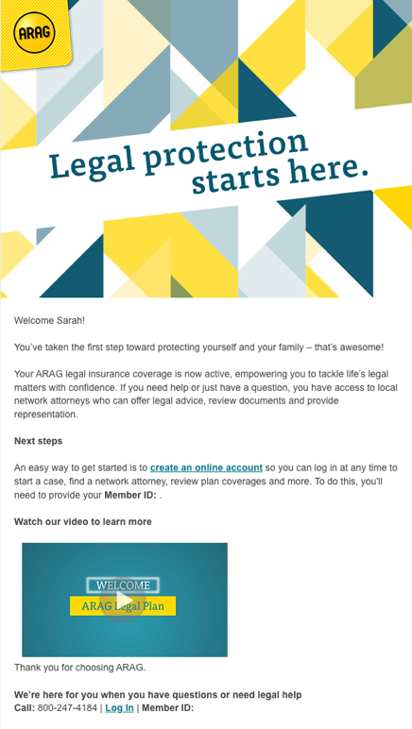
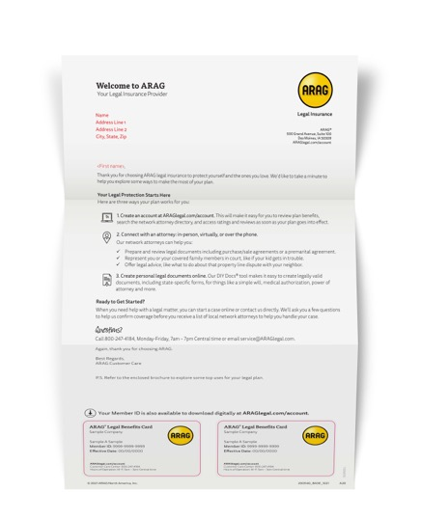
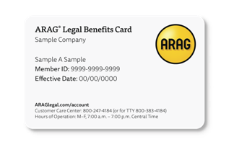
New Member Welcome Kit
Enrollment Confirmation Email
Plan Activation Email
Member Kit - Welcome Letter, benefit card and brochure
CM: - if client is in pilot (digital only option) remove printed kit / slide altogether

Slide 18
Get Started: Request A Case
1
Call or log in to your account when you have a legal matter.
2
Customer Care will walk you through your options or you can go online to get connected to network attorneys.
ARAGlegal.com/account
800-247-4184
3
Meet with your network attorney by phone, in person or virtually to address your legal issue and provide them with your CaseAssist® confirmation number.

Slide 19
Additional Details
More Info
ARAGlegal.com/myinfo Access Code: 18659nm
Call Customer Care 800-247-4184 (Monday – Friday, 7 am to 7 pm CT)
Email
service@ARAGlegal.com
Cost $24.25 per member per month
For purposes of the policy, the Policyholder has defined eligible dependents to mean: Spouse and children until the end of the month that they reach age 26 regardless of student or marital status.

Slide 20
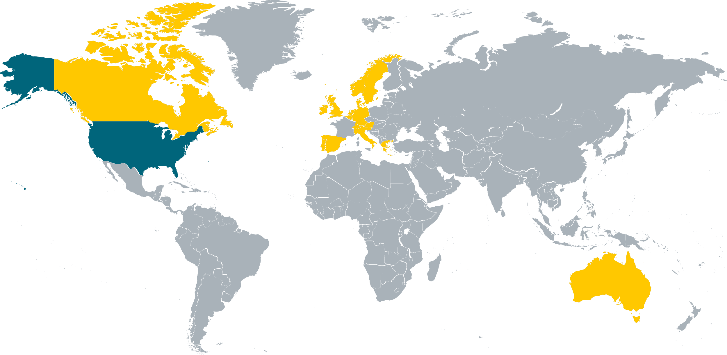
ARAG LEGAL INSURANCE
Singular Focus on Legal and Our Customers
SERVING GROUPS WITH
45+
250 - 410,000
EXPERIENCE OFFERING GROUP LEGAL PLANS IN U.S
Our core belief: Offer legal insurance for all, so more people feel prepared to face life’s legal matters.
YEARS
EMPLOYEES
1,000+
2.2 M
A.M BEST RATED A
CENTER OF EXCELLENCE
2021 TOP WORK PLACES
GROUP CLIENTS
INSUREDS
7+
YEARS AVERAGE CLIENT TENURE
GLOBAL PRESENCE IN
26.3 M
$2.3 B
19
CUSTOMERS WORLDWIDE
WORLDWIDE PREMIUM
COUNTRIES
13%
AVERAGE PARTICIPATION
Based on 2021 ARAG data

Slide 21
Limitations and exclusions apply. Depending upon a state's regulations, ARAG's legal insurance plan may be considered an insurance product or a service product. Insurance products are underwritten by ARAG Insurance Company of Des Moines, Iowa. Service products are provided by ARAG Services, LLC. Eligibility, coverage, limitations and exclusions of identity theft insurance are governed by a separate coverage document. This material is for illustrative purposes only and is not a contract. For terms, benefits or exclusions, contact us at 800-247-4184

